Slide 1
Kaiser Permanente
Developing the product
Product Owner: Nélio Macombo
© 2019 Udacity. All rights reserved.

Slide 2
Create Project Blueprint
A product launch is not just about deploying a beautifully designed,built and thoroughly tested feature. Your company needs to be equally prepared if not more to support every possible customer interaction associated with the product (e.g landing on your company website to learn more about the new feature)
© 2019 Udacity. All rights reserved.
Notes:
[ALL PARTICIPATION]

Slide 3
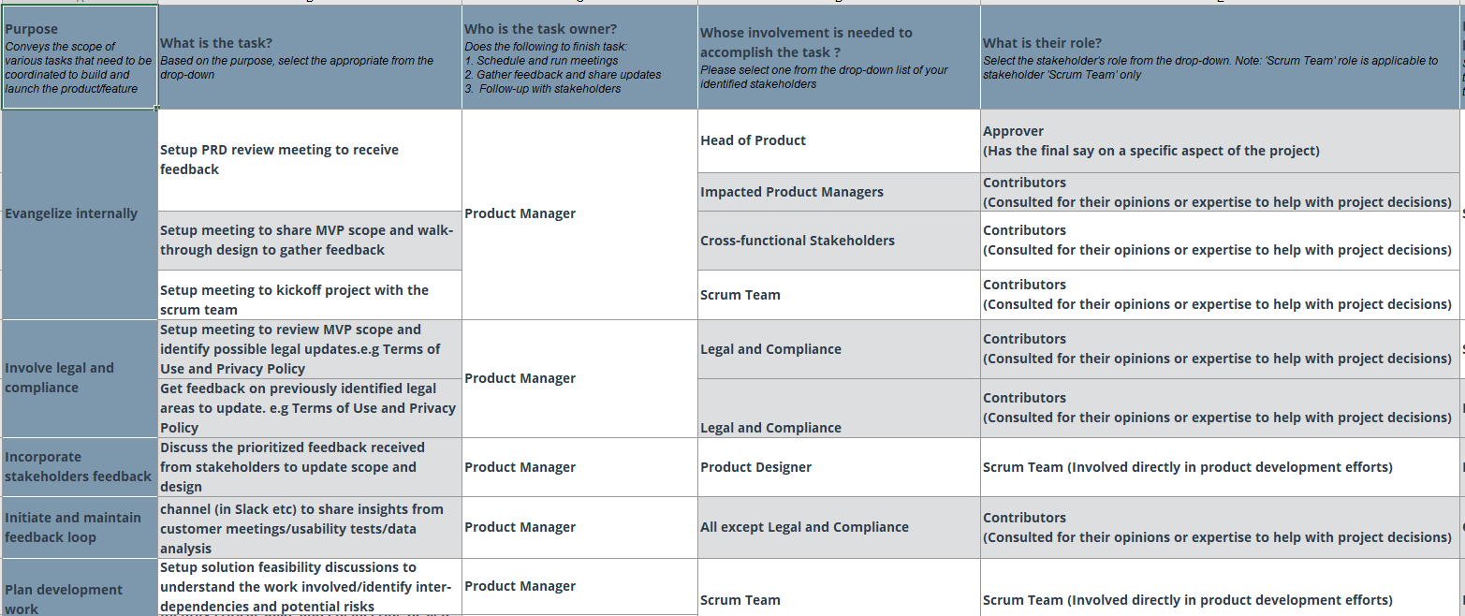
Create a coordination activities map
Link: https://drive.google.com/file/d/1KAP9TzUdOQ5BCe4DBRd2P6Oo5Jj0nfk5/view?usp=sharing
© 2019 Udacity. All rights reserved.

Slide 4
Sprint Meeting Plan
© 2019 Udacity. All rights reserved.
Notes:
[ALL PARTICIPATION]

Slide 5
Sprint Planning Meeting Preparation
Sprint Goal
To be able to increase physical activity by exercise on daily basis
Sprint Backlog (list the prioritized user-stories from the product backlog)
1 | As an engineer that wants to become fitness I want to define my fitness goal to improve my physical activity on the daily basis;
2 | As an athlete I want to create an exercise plan based on my goals to gain mass and build muscles and have all exercise available when my data ends;
3 | As an user who wants to burn fat and eat healthier I want to have a personalized diet plan and physical exercises based on my weight and height;
4 | As an athlete I want to track my progress related to my goal and receive notification summary on weekly basis;
5 | As an engineer I want to have recommendations of exercises and daily diet tips that helps me achieve to my goal and also I to receive notification summary on weekly basis;
Sprint Prioritization Logic
Implement the a physical recommendation plan that helps users exercise better; Implement diet recommendation systems that helps users eat healthier;
© 2019 Udacity. All rights reserved.

Slide 6
Sprint Planning Meeting Preparation
Sprint Goal
Allow support track the exercise on realtime, share feedback notifications and suggest meals for diet;
Sprint Backlog (list the prioritized user-stories from the product backlog)
1 | As an user I want to track the exercises on the daily basis and have a weekly summary report of mu on real time my performance based on my goal;
2 | As an user I have notifications about time to exercise and also time to eat;
3 | As an user I have the option to offline access to exercises when I end up with mobile data or lost access toto wi-fi;
4 | As an user I want to check exercises on daily, weekly and monthly basis and also the alternatives version to perform with machineray aand without machineraty;
5 | As an user I want I want to track my weight, blood pressure and heartbeat;
Sprint Prioritization Logic
Implement the Tracking feature on the App; Implement access offline access and Notification feature;
© 2019 Udacity. All rights reserved.

Slide 7
User Story 1
User Story | As a hardcore food lover I want an app that allow me exercise and explore different varieties of food and fruits to keep me healthy all the time.
Design | https://www.figma.com/proto/nAjobVuWccXProfn5Ow6pZ/Healthier-Guru-V2?node-id=2%3A3&scaling=min-zoom
Acceptance Criteria | The app should store my data after first Sign In and not ask for credentials every time; The app should be work allow user to exercise offline; The app should create a physical and diet plan based on the user fitness goals; The app should not crashed and automatically updated
Assumptions | The app will satisfy the user UI expectations and will not face any issues; The app will populate recommend the diet based on the user weight, height and food restrictions;
© 2019 Udacity. All rights reserved.

Slide 8
User Story 2
User Story | As an engineer I need an app that helps me exercise in order to recuse my sedentary habits and build few muscles;
Design | https://www.figma.com/proto/nAjobVuWccXProfn5Ow6pZ/Healthier-Guru-V2?node-id=2%3A3&scaling=min-zoom
Acceptance Criteria | The app will have subscription based model; As a physical user, I want a profile section that I can see to track my daily exercise performance. As a food lover, I want to have recommendations based on my food restrictions history with accessible receipts or places that I can go to eat; Recommendations shall be proactive suggested via push notifications!”
Assumptions | The app may or may not agree upon the certain terms and conditions The app shall pass the certain legal agreement in order to proceed ahead
© 2019 Udacity. All rights reserved.

Slide 9
User Story 3
User Story | As a Project Manager woman, I want an amazing physical exercise assistante app that helps me relieve stress from my daily routine without going to gym.
Design | https://www.figma.com/proto/nAjobVuWccXProfn5Ow6pZ/Healthier-Guru-V2?node-id=2%3A3&scaling=min-zoom
Acceptance Criteria | As a user, I want to see my progreess based on the exercises that I performed on a weekly basis. The physical exercise database is updated on weekly bassis to respond the user goal;
Assumptions | The app can show funny animations when the users achieve the goal; The app can ask for goal and proactive monitor and suggest exercise based on the day of the week;
© 2019 Udacity. All rights reserved.

Slide 10
Acceptance Criteria (User Stories)
The app perfectly works fine on Android and Apple Store (Latest Version);
Users will get an important notifications so that they always be remembered to exercise or eat healthier;
The user can share their progress with their friends;
The users has a feature to track and report the status of the goal achievement;
The users has a multi-functionality features from physical coaching app to a diet guru;

Slide 11
Decoding API Documentation
© 2019 Udacity. All rights reserved.
Notes:
[ALL PARTICIPATION]

Slide 12
API Documentation
Kaiser Permanente is looking to enter into the preventative care space to help their patient base increase physical activity and improve on healthy habits. While the overall goal is improved patient satisfaction and well being, the specific financial goal is reduced cost by emphasizing improved health prior to any adverse conditions developing. Overall, KP wants to decrease spending on conditions such as type 2 diabetes

Slide 13
API - Kaiser Permanente
Based on the API documentation how would you update your solution and design? | The API representation provide a lot of useful fields, it is a good RESTful implemented API with design principles that can leverage the good feature implementation and scalability of the health solution that we want to deliver. From my research using the API, I saw that I can use this implementation in order to restrutucture the overall aplication infraestruture on the following Data Objects: Fitness Activity, Routine, Nutirition, Sleep, Weight, Diabetics and biometrics;
Based on your high-level understanding of the API documentation, are there any details that you want to discuss with engineering to refine solution and/or determine feasibility | Based on my high lever overview of the API are will discuss with the Team about Biometrics Feature, Sync between Apps and Devices, Connection with other Health APIs and Push Notifications. Here I would request the team to answer questions: Which parameters the should send throw the API ? And which I receive ? Does the API documentation cover error cases / codes? Which parameters we should have in return ? How the error message are send or displayed ? How we deal with Error Handling ? Does the API documentation cover messages/methods, fields and values? What technology choices does the API support? Does the API give you a receipt? Does the API allow reference data updates?

Slide 14
Re-prioritize Sprint Backlog
As a PM, unexpected issues and new feature requests will require you to triage them efficiently and re-prioritize the sprint backlog without impacting the roadmap deliverables significantly
© 2019 Udacity. All rights reserved.
Notes:
[ALL PARTICIPATION]

Slide 15
Issue 1: Landing Page loading too slow
Determine impact and criticality to prioritize issue | The landing page issue can occur in Android/Apple store/Laptop Device This can be due to heavy server load on the specific timeframe Need to check the bandwidth and how many people visit to the website in a given timeframe. The images on the portal are too large to display The app has not been updated by the user; This issue has a medium criticality since the users a able to access the content but waiting long to load it;
Next Steps You would carry out typically using JIRA (ticketing tool), communication channel (Slack) | Request the sessionsd on google analytics which caused the issue via a ticket on Jira and message on Slack with medium criticallity; Request the complete error report via medium criticality ticket on Jira requesting information about the duration and spikes of the issue; ;
Would you take additional steps ? | Would check with the tech team about the exact issue Does this happened to all the customers? Please update the geographical location and the timezone. Have all our servers has been updated locally in our servers?
© 2019 Udacity. All rights reserved.

Slide 16
Issue 2: Misaligned fields in Profile Settings
Determine impact and criticality to prioritize issue | The profile settings doesn’t allows user to edit the input the Birthday date When users try to edit the Birthday Date, this field is highlighted grey and sometimes it’s unclickable; This field is relevant and it is not functioning well; The Birthday Field mismatched with the phone number field; This issue is classiefid as High due the features that are linked with this field;
Next Steps use ticketing tool (JIRA), and communication channel (Slack) | I will inform the dev team (by putting one ticket assigned as High criticallity on Jira and drop and message on slack channel refering the same ticket)to make to implement changes on the field in order to be clear to the customer; The field should not be grayed out and should be a separate placeholder; The field should be in bold and a specific color so that the customer doesn’t gets confused.
© 2019 Udacity. All rights reserved.

Slide 17
Respond to Customer Service Manager’s Email
Determine impact and criticality to prioritize the issue (1 - Critical; 2 - High; 3 - Normal; 4 - Low) | The desired action is very critical and much needed to solve in order to avoid the customer hampering. The app should not be crashed after the certain activity from the user; The app should take back to the main screen once the order has been placed; The app should allow users to exercise withoud date or wi-fi enabled;
Next Steps You would carry out typically using JIRA (ticketing tool), communication channel (Slack) | Kindly have a word with the app developer team and fix this asap Please make sure the testing before making it to the public List down the exact issues once the app restarts it.
Sample Email Response | Dear Manager XYZ, With reference to your email stated below. I would like to highlight the few points. To the customer experience point of view, we will double test with the team, and after we conclude that everthing is ok we will to the public. The sets of different guidelines make it suitable to take the action forward and more reliable
© 2019 Udacity. All rights reserved.

Slide 18
Handle Potentially Difficult Situations
© 2019 Udacity. All rights reserved.
Notes:
[ALL PARTICIPATION]

Slide 19
Respond to CEO or GM’s request via email
Assessment and result | In response to your email, have incorporated few highlighted points The source code be implemented on priority The action can be taken immediately w.r.e The tasks has been assigned to the tech team to work on the desired task The UI and other element has been taken care off by the designer team
Sample Email Response | Dear CEO, In reference to your last email, I would like to update with the following feedback: The API which we have worked a couple days ago with desired features we manage to finish the implementation and it was tested and approved by my the QA & Tech team. However, now we are conducting more tests in order to ensure that all is fine and we hope to conclude on the next week. I suggest to re-schedule a demo session for the next 02 weeks. We are looking forward to hearing from you, Best Regards,
© 2019 Udacity. All rights reserved.

Slide 20
Step-in and guide the scrum team at stand up
Video Response | Link : https://drive.google.com/open?id=1SKKRgfZB-DI9QipZVqYzGdfGFHfs0bJX
© 2019 Udacity. All rights reserved.

Slide 21
Handling Resource Constraints
List 2- 3 activities that you would carry out as a PM to unblock the scrum team immediately ? | Quickly Discuss Project Blockers on daily Scrum; Identify, discuss, and bust through project blockers. Train myself and the Team in order to recognize when are facing blockers;
Since the QA team member is shared across multiple projects, how would you coordinate with other PMs to de-risk your project and raise appropriate visibility ? | Since it’s as important as the other tasks, we can collaborate this together We can keep the tech time for aside as the designer team is crucial to us Dev-ops team has a good amount of free time. We can use them for at least for two weeks.
Since there is a potential risk, it is important to raise visibility amongst appropriate stakeholders | We have only a week time to launch our new feature around 2 to 3 weeks. This is super important to us. We have agreed upon to the conclusion to go ahead with the designer team The tech leads can’t wait because of their tight deadlines.
© 2019 Udacity. All rights reserved.

Slide 22
How would you handle stakeholder feedback?
Feedback Assessment | Be ready to prepare for the worst if in case of any technical issue Our primarily goal is to deliver the order on time Phsysical Exercise offline feature and Push Notifications will play a important technical challenges to improve overall satistaction; API’s decoding is one of the essential tasks which we should take care off.
Video Response | Link: https://drive.google.com/open?id=1HgX66_PMORCxgy6tN5v0FlZXHyesewDL
© 2019 Udacity. All rights reserved.

